Slide 1

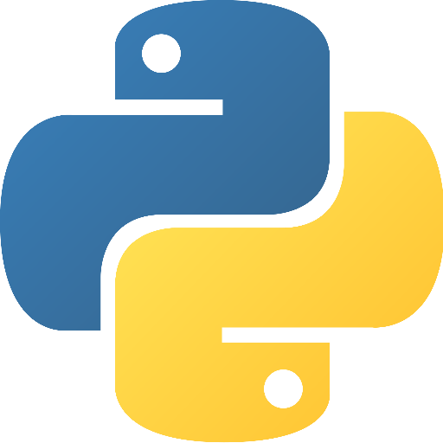
Introduction to Python

Slide 2


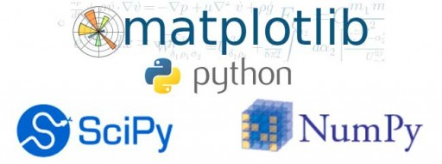
What is Python?
Being a general-purpose programming language, it can be used for:
Web development (server-side),
Software development, or just simple scripting
Scientific computing

Slide 3

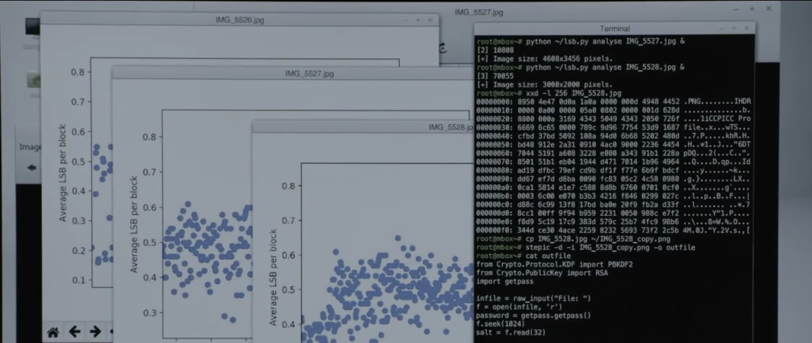
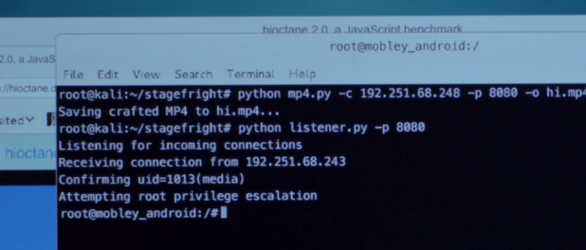
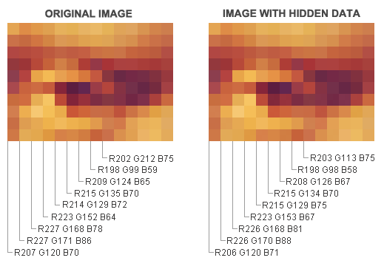

Slide 4
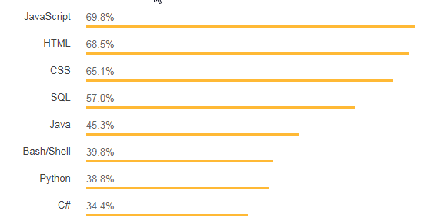
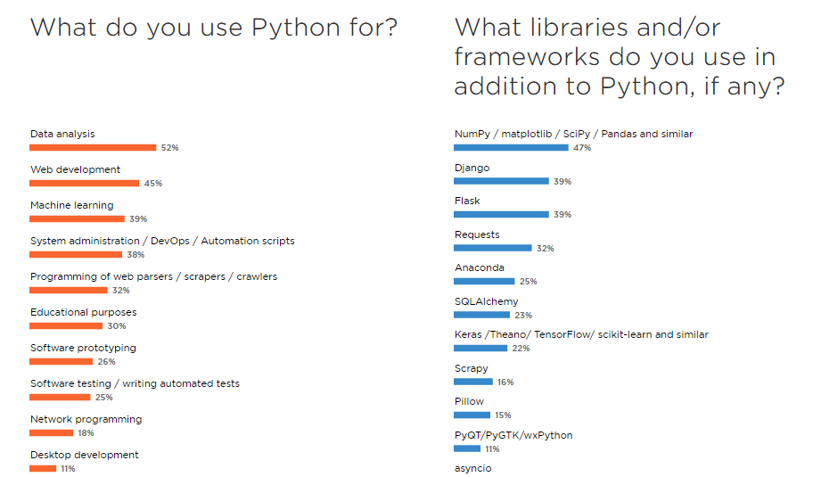

Python’s rise to fame
Top Programming Languages 2018
Statistics extracted from:
Stackoverflow Developer Survey 2018
The State of Developer Ecosystem 2018 - Infographic | JetBrains

Slide 5
Advantages
Cross-platform. Python runs on all major operating systems (Windows, Mac, Linux)
High-level. Python has a simple syntax similar to the English language.
Imperative. Python runs on an interpreter system, meaning that code can be executed as soon as it is written. This means that prototyping can be very quick.
Open-source and widely supported. Supported by an active community, means your questions will likely have answers
(PEP 8) Simple yet efficient syntax. Emphasizes readability

Slide 6
Coding in Python

Slide 7
Python quickstart
No ; { } s.
Use indents (4 spaces)
Dynamic typing. A variable is created the moment you first assign a value to it. No variable declarations required int a = 1;
Basic Data Types:
Integer, Float, String, Boolean
Data Structure : List, Dictionary

Slide 8
Code samples
print("Hello, World!")
x = 5 if x > 2: print(“x is greater than two!")
Comments start with a #, and Python will render the rest of the line as a comment:
# This is a comment. print("Hello, World!")

Slide 9

Numbers
int
float
complex

Slide 10
Specify a variable type
There may be times when you want to specify a type on to a variable. This can be done with casting.
int()
float()
str()

Slide 11

String Literals
'hello' is the same as "hello".
Square brackets can be used to access elements of the string. (more in “Array indexing”)

Slide 12
Python Operators
Arithmetic operators
Assignment operators
Comparison operators
Logical operators
Identity operators
Membership operators
Bitwise operators

Slide 13
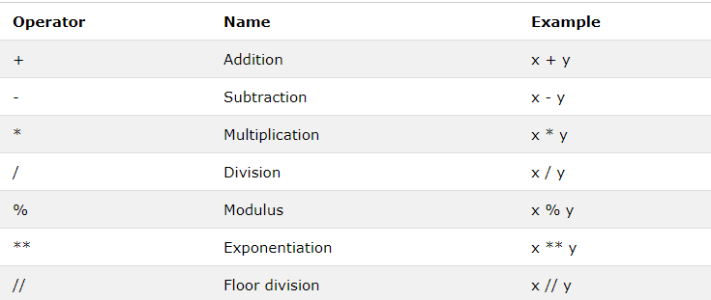
Examples- Arithmetic Operators

Slide 14
Arrays

Slide 15
Python Collections (Arrays)
List is a collection which is ordered and changeable. Allows duplicate members.
Tuple is a collection which is ordered and unchangeable. Allows duplicate members.
Set is a collection which is unordered and unindexed. No duplicate members.
Dictionary is a collection which is unordered, changeable and indexed. No duplicate members.
[‘a’, ‘b’, ‘c’]
(‘a’, ‘b’, ‘c’)
{‘a’, ‘b’, ‘c’}
age = {‘Bob’: 24, ‘Dave’: 39}

Slide 16
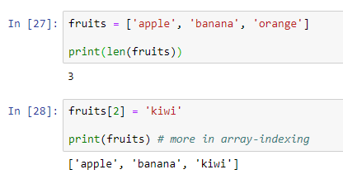
List
A list is a collection which is ordered and changeable. In Python lists are written with square brackets.
You access the list items by referring to the index number:
To change the value of a specific item, refer to the index number:

Slide 17
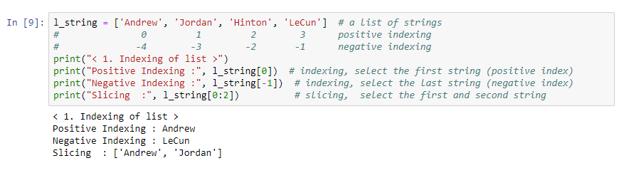

Array Indexing

Slide 18
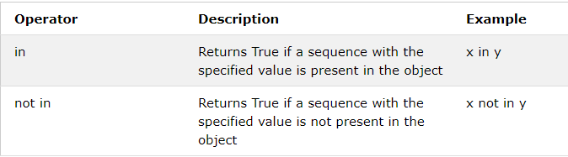
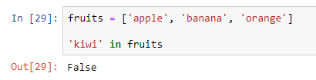
Python Membership Operators

Slide 19
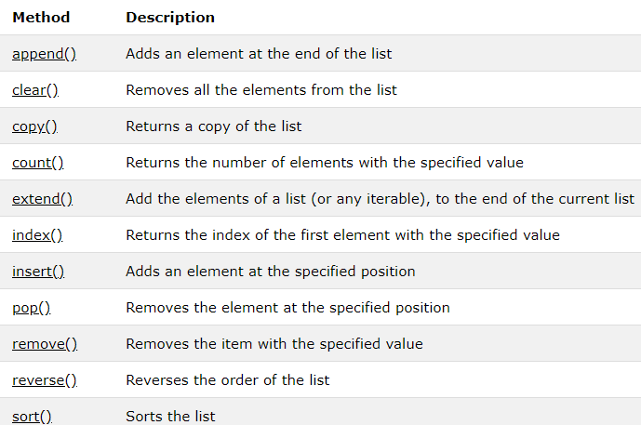
List methods
Example:
array = [‘a’, ‘b’, ‘c’]
array.append(‘d’)

Slide 20
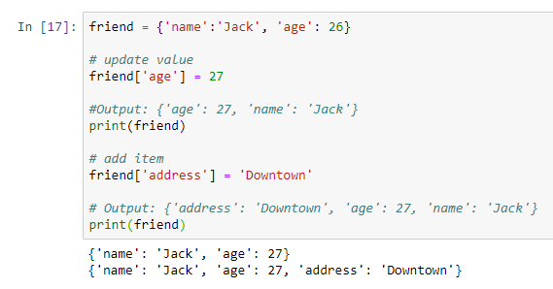
Dictionary
A collection of key: value pairs

Slide 21
Conditionals

Slide 22
Boolean Operators
Equals
Not Equals
Less than
Less than or equal to
Greater than
Greater than or equal to
a == b
a != b
a < b
a <= b
a > b
a >= b

Slide 23
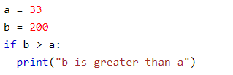
Python Conditions and If statements
These conditions can be used in several ways, most commonly in "if statements" and loops.
An "if statement" is written by using the if keyword.

Slide 24
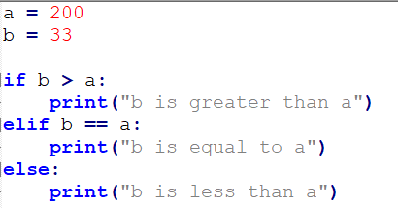
Elif, Else

Slide 25
Loops

Slide 26

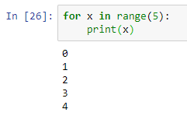
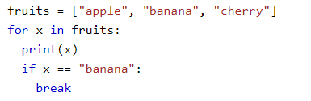
For Loop
With the for loop we can execute a set of statements, once for each item in a list, tuple, set etc.
[Common use case] The range(n) iterable returns a sequence of numbers, starting from 0 till n-1.
With the break statement we can stop the loop before it has looped through all the items

Slide 27

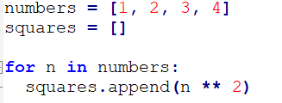
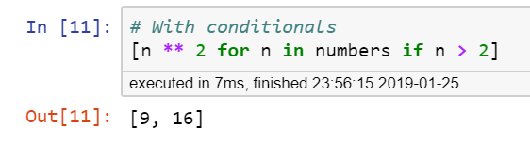
Tip: List comprehension
Instead of
We do
We can also do….

Slide 28
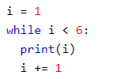
While
With the while loop we can execute a set of statements as long as a condition is true.
With the break statement we can stop the loop even if the while condition is true:
With the continue statement we can stop the current iteration, and continue with the next:

Slide 29
Functions

Slide 30


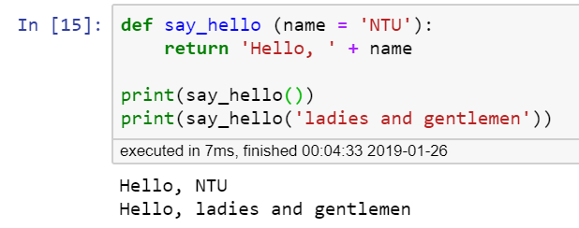
Function
In Python a function is defined using the def keyword:
To call a function, use the function name followed by its parameters contained within a pair of parentheses

Slide 31
Exercises

Slide 32
Exercises
Find max value in list of numbers
Check whether a world is a palindrome or not (A palindrome is a string that reads the same forwards and backwards, e.g. civic, radar, racecar)
Write a function that takes a list of numbers and another number. The function decides whether or not the given number is inside the list and returns an appropriate Boolean (truth value).
Suppose you work at a ticket counter at a theme park. During this promotional period, it is giving special price ($4) to children (age < 7) and senior citizens (age > 70), while others are still priced at $10. Write a function that takes a list of visitors_age and outputs the ticket prices they have to pay.

Slide 33
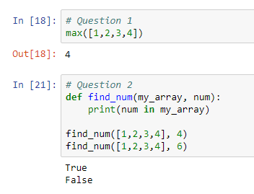
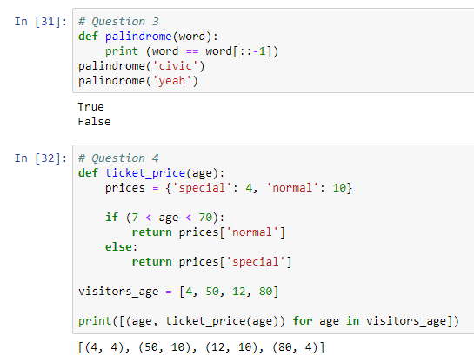
Answers

Slide 34
For more information
https://www.w3schools.com/python/default.asp https://www.sololearn.com/Course/Python/
You can visit w3schools or SoloLearn to learn more

